Slide 1




SAE NIS EFFI-CYCLE >>>Drive The Future<<<
Power Enhancement Season
CAD Report
21028
INVINCIBLES 5.0

Slide 2
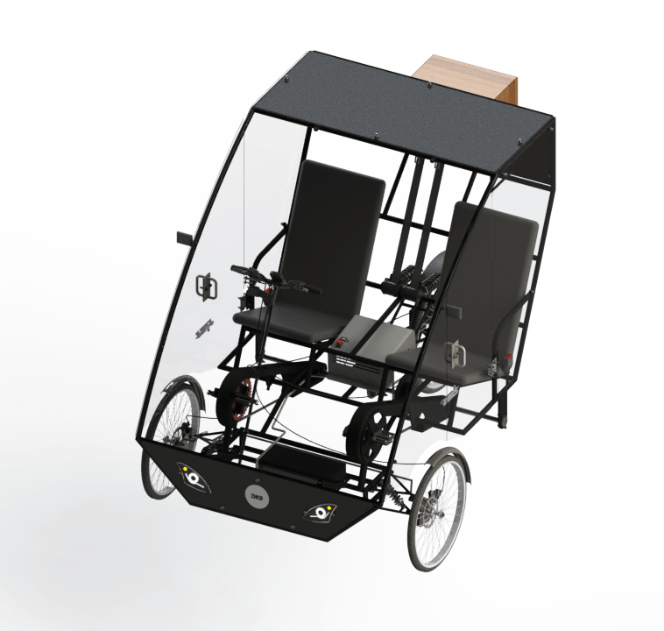
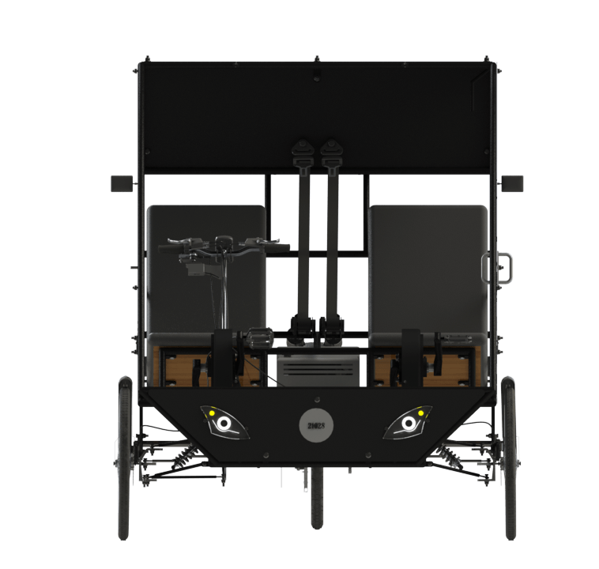
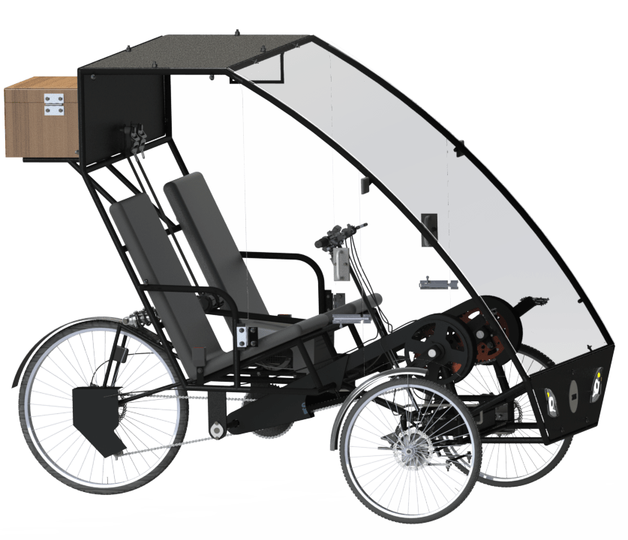
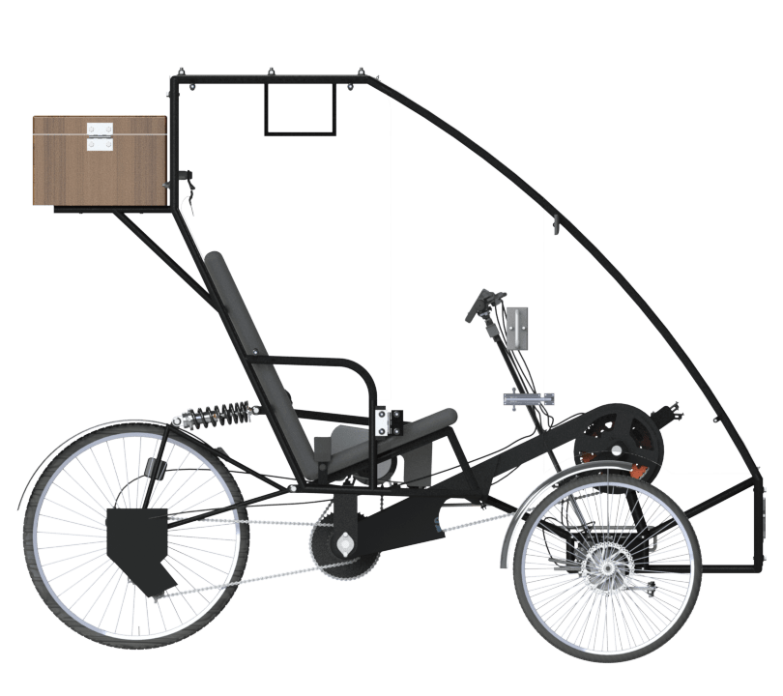
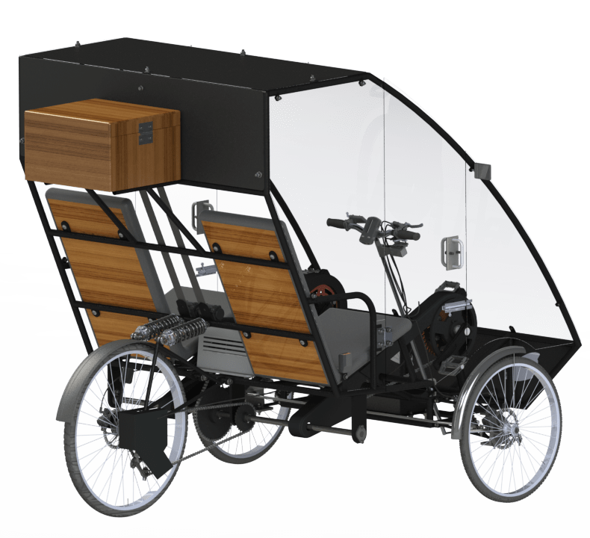
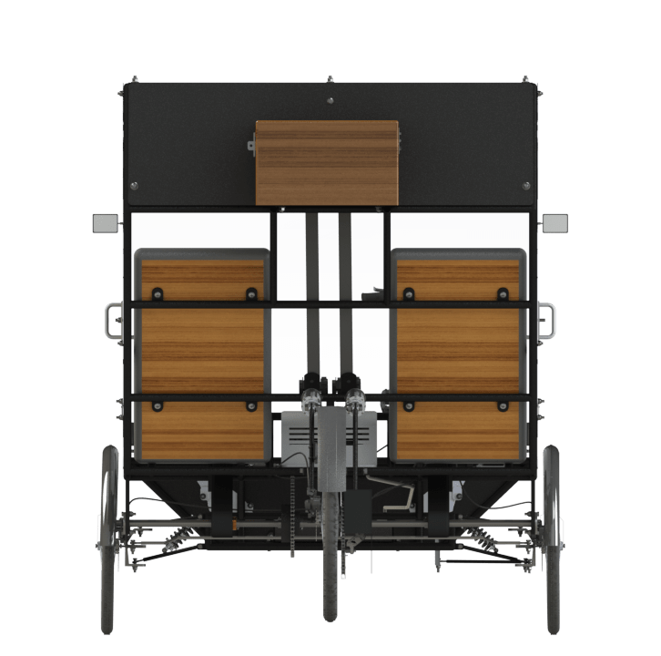
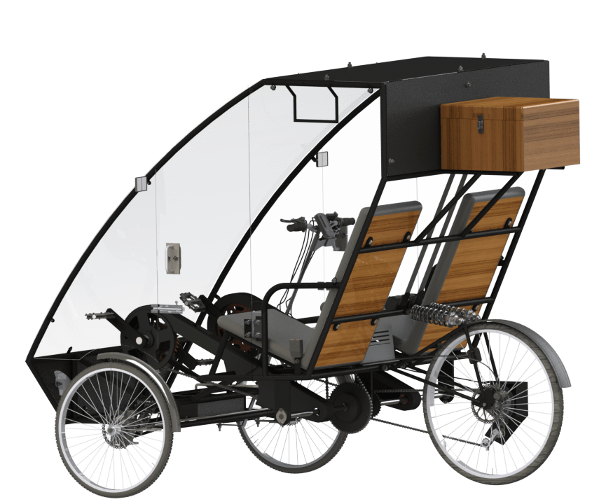
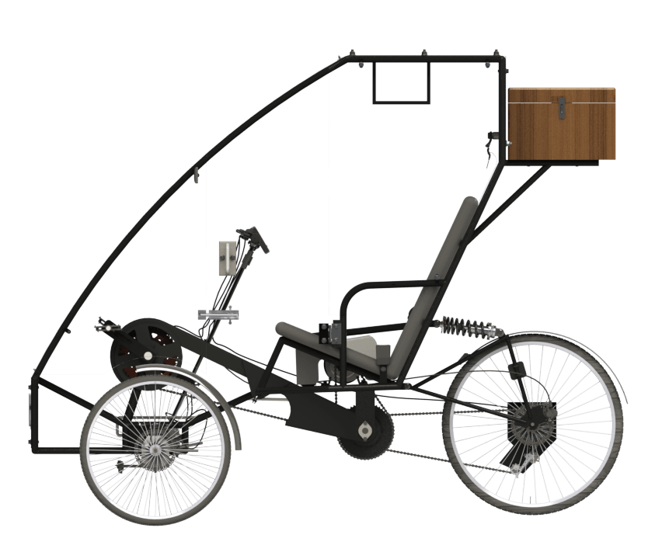
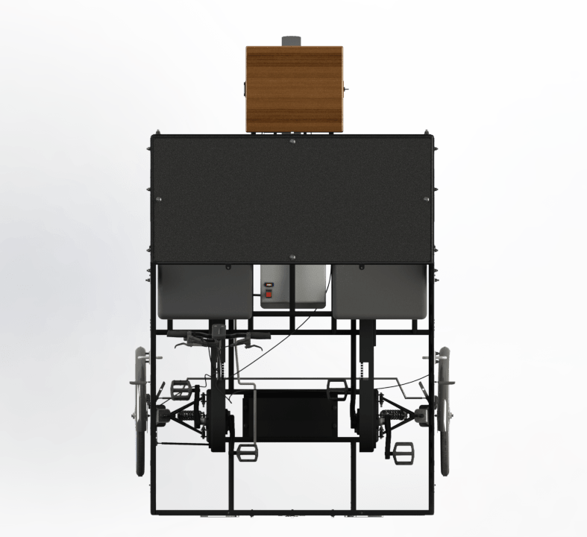
1

Slide 3
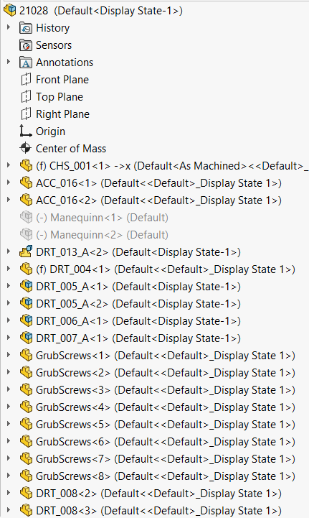
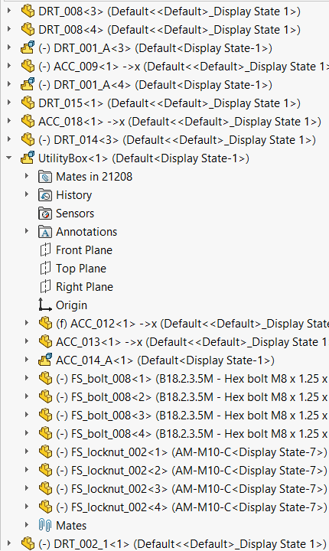
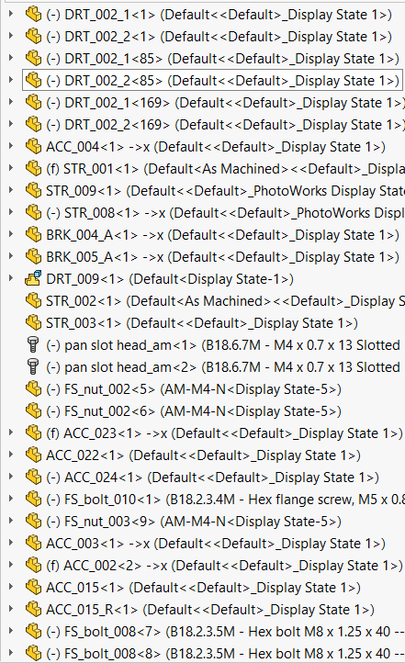
Assembly Tree
2a

Slide 4
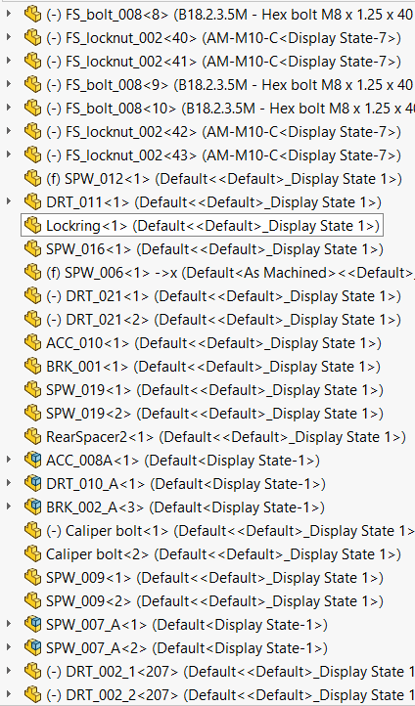
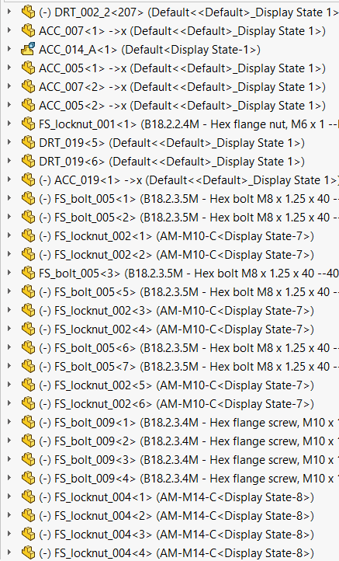
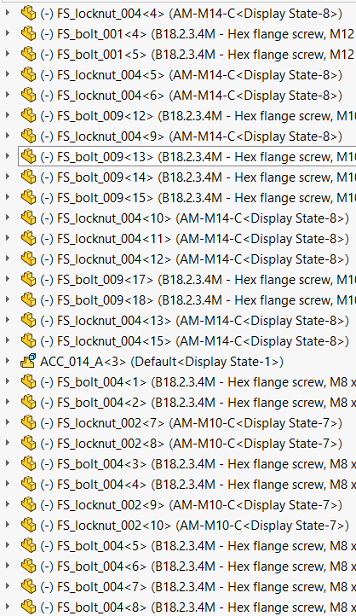
Assembly Tree
2b

Slide 5
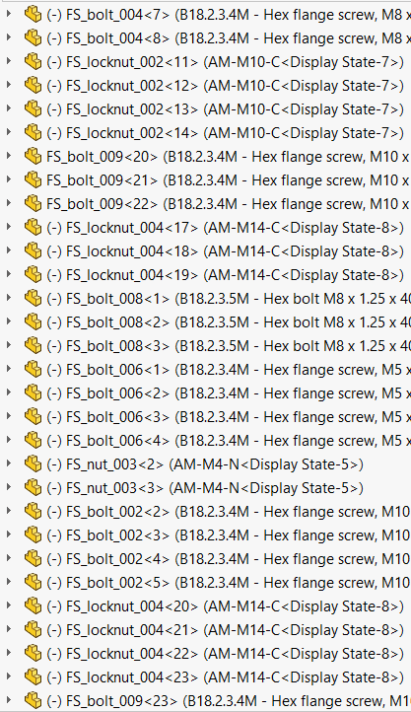
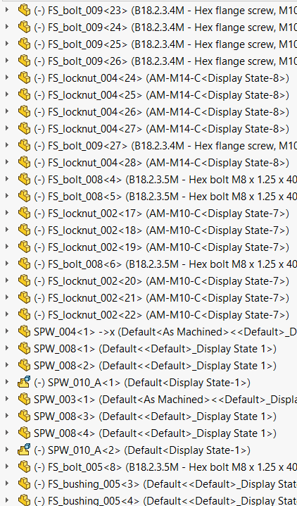
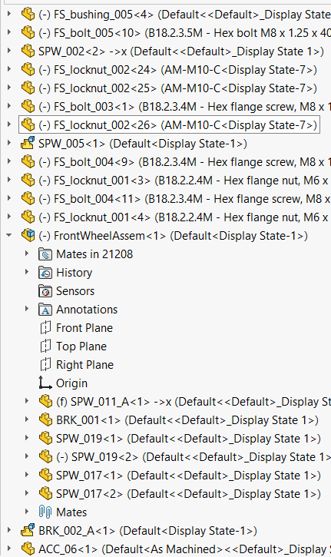
Assembly Tree
2c

Slide 6
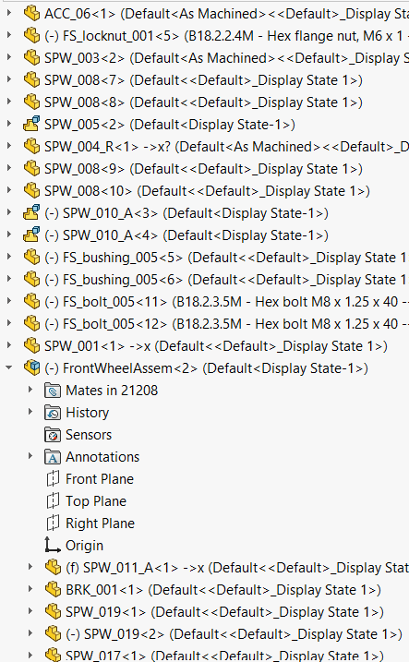
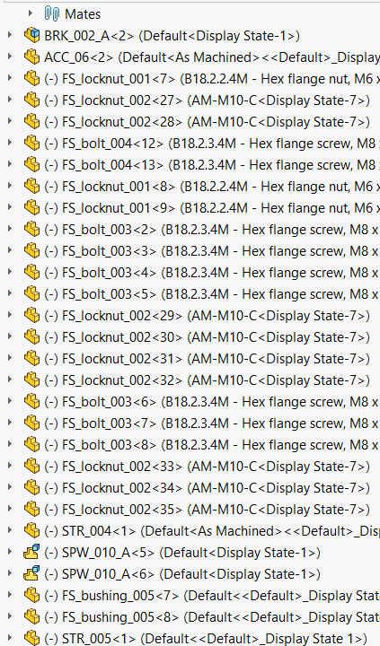
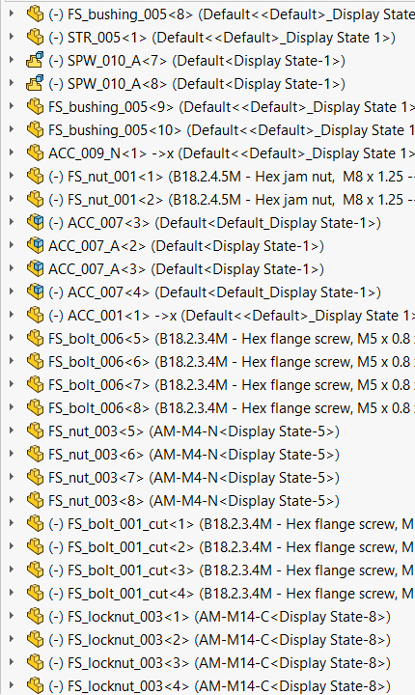
Assembly Tree
2d

Slide 7
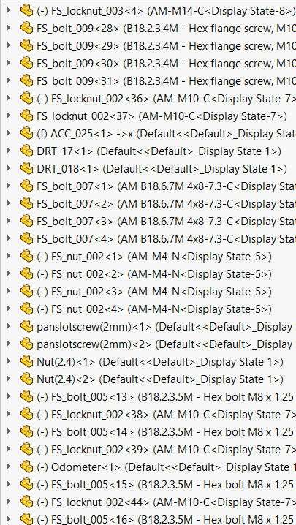
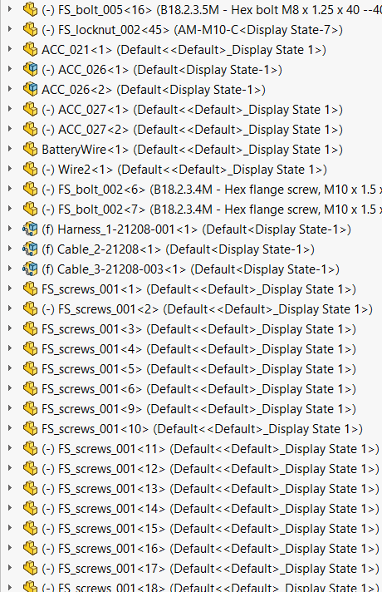
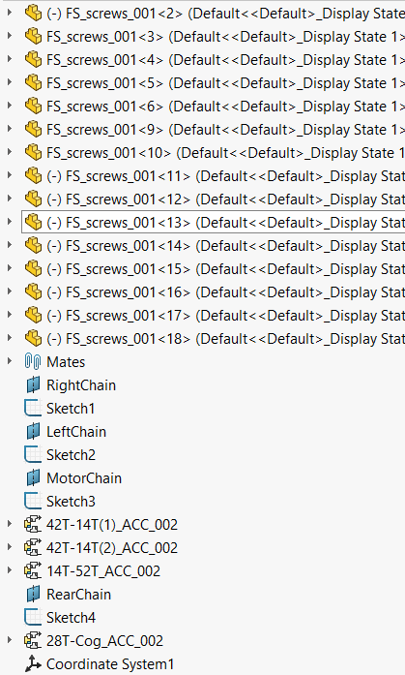
Assembly Tree
2e

Slide 8
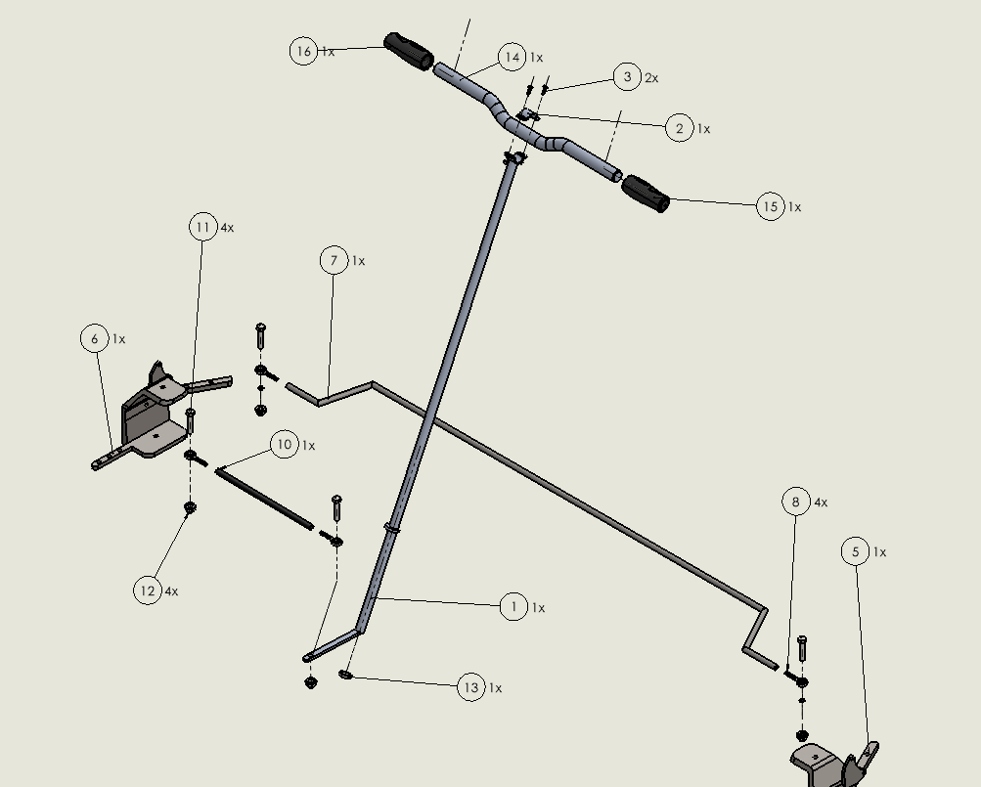
Steering
3
B. No | Part Name
1 | Steering Column
2 | Clamp
3 | Pan Slotted Screw M4
4 | M4 Nut
5 | Steering Arm on left knuckle
6 | Steering Arms on Right Knuckle
7 | Tie Rod b/w knuckles
8 | Eye Ball Joint
9 | M8 Nylon Bushing
10 | Tie Rod b/w knuckle and steering column
11 | Grade 8.8 M8 Flanged Bolt
12 | Grade 8.8 M8 Nylon Locknut
13 | Steering Column Bearing
14 | Handlebar
15 | Left Handle Grip
16 | Right Handle Grip/Throttle

Slide 9
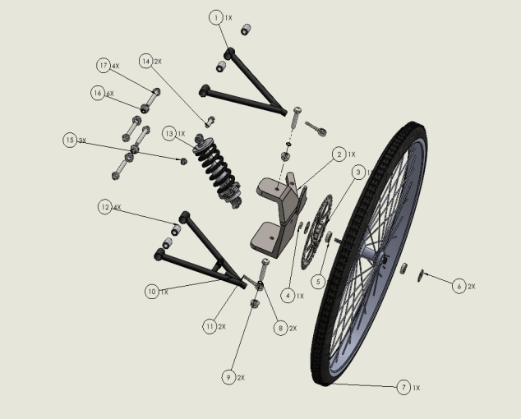
Suspension, Wheels and Tires
4a
B.No | Part Name
1 | Upper A arm
2 | knuckle
3 | Brake disc
4 | M7 Nutgrade 8.8
5 | Wheel bearing
6 | Wheel lockring
7 | Front wheel
8 | Grade 8.8 M8 flanged bolt
9 | M8 Nylon Bushing
10 | Lower Control Arm
11 | Eye ball joint
12 | Bushing
13 | Front suspension
14 | Grade 8.8 M8 flanged bolt 25mm
15 | Grade 8.8 M8 nylon locknut
16 | Grade 8.8 M8 nylon locknut
17 | Grade 8.8 M8 flanged bolt 40mm

Slide 10
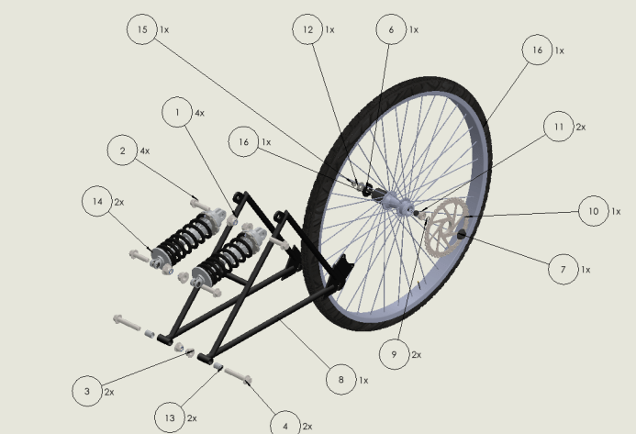
Suspension, Wheels and Tires
4b
B.No | Part Name
1 | M12 Nylon Locknut
2 | Grade 8.8 M12 flanged Bol 30mm
3 | Grade 8.8 M12 Nylon Locknuts
4 | Grade 8.8 Flanged Bolt 45mm
5 | Rear wheel Assemble
6 | Cassette Hub Lockring
7 | Wheel Hub Lockring
8 | Rear Triangular Swing arm
9 | Washer 7mm diameter
10 | Brake Disc
11 | Wheel bearing
12 | Spacer 7mm dia
13 | Nylon Bushing
14 | Rear suspension
15 | Grade 8.8 M8 Nylon Locknut

Slide 11
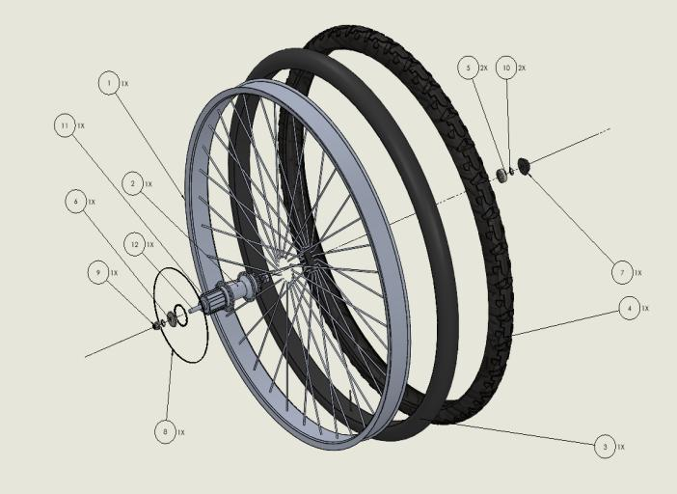
Suspension, Wheels and Tires
4c
B.No | Part Name
1 | Wheel Rim
2 | Wheel Hub
3 | Wheel Tube
4 | Wheel Tyre
5 | Wheel bearing
6 | Wheel Lockring
7 | Wheel Hub Lockring
8 | Dork Disc
9 | Grade 8.8 M8 Nylon locknut
10 | Washer 7mm Dia
11 | Cassette Hub
12 | Wheel Axle

Slide 12
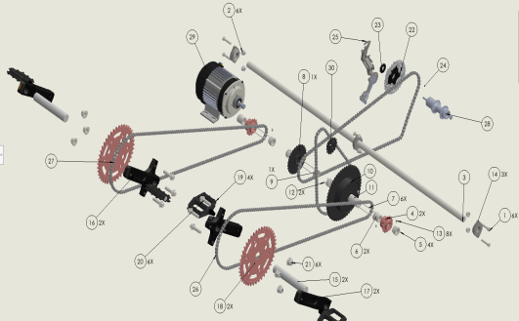
Drivetrain
5
B.No | Part Name
11 | Sprocket joint for 52T sprocket
12 | Square Key 2
13 | Grub Screw
14 | Flanged Bearings
15 | Crankset Shaft
16 | Crank Arm 1
17 | Crank arm 2
18 | 42T Sprocket
19 | Pedal
20 | Grade 8.8 M12 Flanged Bolt 30mm
21 | M12 Nylon Locknut
22 | 13 Speed Cassette
23 | Cassette Hub Locking
24 | Dork Disc
25 | Derailleur
26 | Chain
B.No | Part Name
27 | Chain
28 | Wheel Hub
29 | Motor
30 | 14T Sprocket
B.No | Part Name | B.No | Part Name
1 | Grade 8.8 M8 Flanged Bolt | 6 | Sprocket Joint 2
2 | Grade 8.8 M8 Nylon Locknut | 7 | Square Key 1
3 | Transmission Shaft | 8 | 28T sprocket
4 | 14T Sprocket with ratchet | 9 | Sprocket joint for 28T sprocket
5 | Sprocket Joint 1 | 10 | 52T sprocket with Ratchet

Slide 13
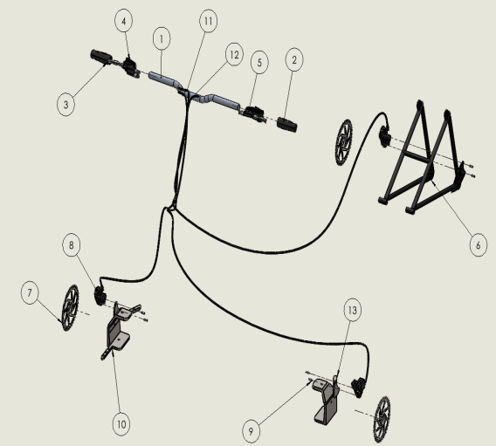
Brakes
6
B.No | Part Name
1 | Handle Bar
2 | Left Handle Grip
3 | Right Handle Grip/Throttle
4 | Front Brake Lever
5 | Rear Brake Lever
6 | Rear Triangular Swing Arm
7 | Brake Disc
8 | Brake Calliper
9 | Calliper Bolt
10 | Right Knuckle
11 | Front Brake Cable
12 | Rear Brake Cable
13 | Left Knuckle

Slide 14
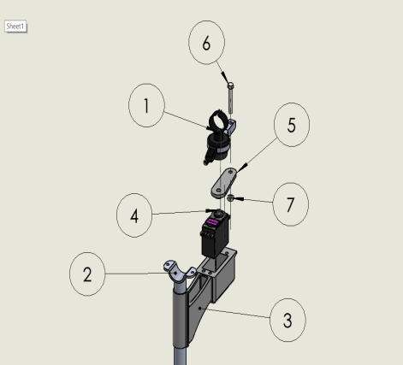
Innovation
7
B.No | Part Name
1 | Shifter
2 | Steering Column
3 | Motor Housing
4 | Servo Motor MG996R
5 | Shaft
6 | M5 Bolt (35 mm)
7 | M5 Nut

Slide 15
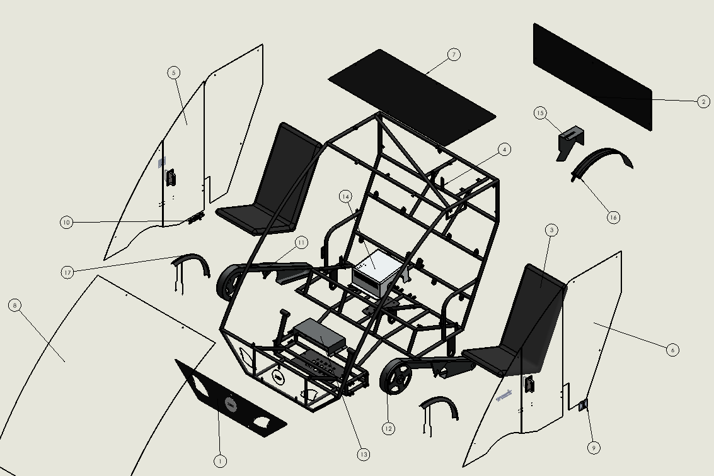
Frame, Seats
8
B.No | Part Name
1 | Front Panel
2 | Rear Panel
3 | Seats
4 | Chassis
5 | Door
6 | Side Panel
7 | Top Panel
8 | Front Fairing
9 | Hinge
10 | Door Lock
11 | Chain Guard (Right)
12 | Chain Guard (Left)
13 | Battery Guard
14 | Motor Housing
15 | Cassette Guard
16 | Rear Mud -Guard
17 | Front Mud -Guard

Slide 16
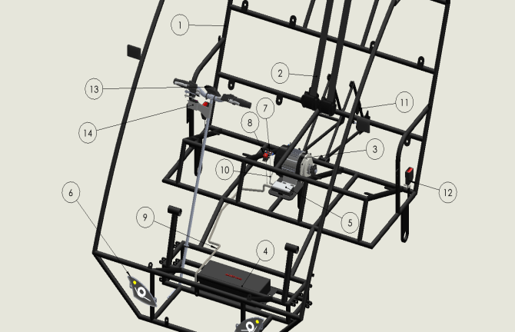
Electrical and Accessories
9
B.No | Part Name
1 | Chassis
2 | Seat Belt
3 | Motor
4 | Battery
5 | Controller
6 | Headlights
7 | Battery Indicator
8 | Kill Switch
9 | Battery wiring
10 | Wiring Harness
11 | Cadence Sensor
12 | Seat Buckle
13 | Odometer
14 | Innovation Assembly

Slide 17
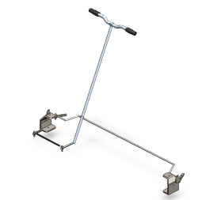
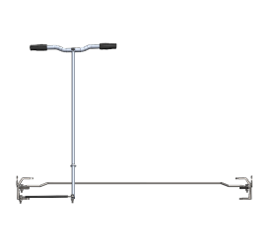
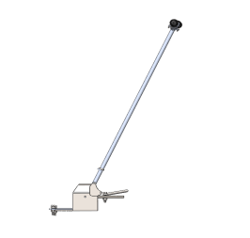
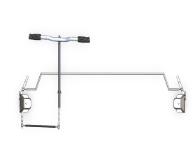
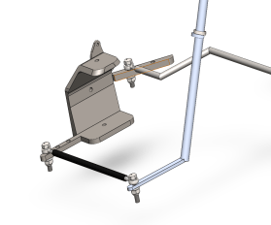
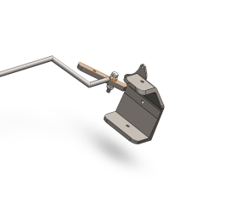
Steering Subsystem
10

Slide 18
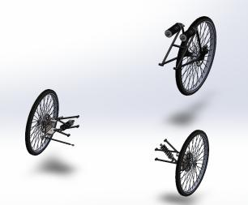
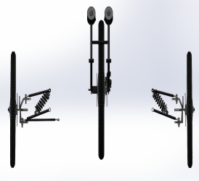
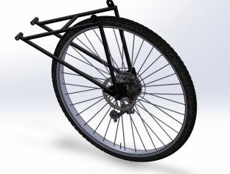
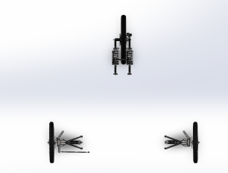
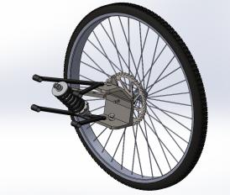
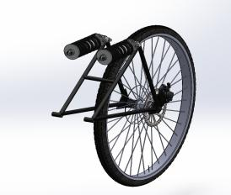
Suspension, Wheels and Tires
11
Front view – Subsystem Assembly
Side view – Subsystem Assembly
Top view – Subsystem Assembly
Sectional view – Wherever required for better understanding
Sectional view – Wherever required for better understanding

Slide 19
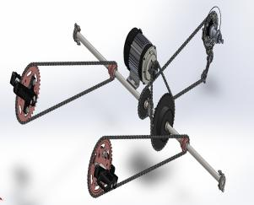
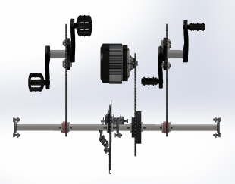
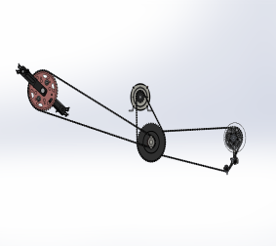
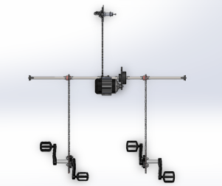
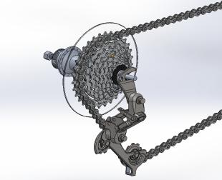

Drivetrain Subsystem
12

Slide 20





Brakes Subsystem
13

Slide 21






Innovation
14

Slide 22






Frame, Seats and Other
15

Slide 23






Electricals and Accessories
16

